Slide 1
Adventure Works
Sales Performance Analysis | 2010 – 2014
Excel
Power BI
Tableau
Group – 5 | Adabala Venkatesh Durga Sai | Prajakta Koli | Shraddha Muneshwar | Rohit Yadav | Dasari Venkatesh.

Slide 2
Introduction
About the Company
Business Goals
Adventure Works Cycles is a large multinational manufacturing company that produces and sells metal and composite bicycles.
Headquarters: Bothell, Washington with 290 employees.
Operates in North America, Europe & Asia.
Manufacturing plant acquired in Mexico (2000s).
Mexico plant became the sole manufacturer for touring bicycles from 2001.
Broaden market share by targeting best customers
Extend product availability via an external website
Reduce cost of sales through lower production costs
Analyze regional and product performance
Improve data-driven decision making
Adventure Works | Sales Analysis 2010–2014

Slide 3
Project Objective
Analyze the Adventure Works dataset using Excel, Power BI, and Tableau — building interactive dashboards and comparing how each tool handles data preparation, calculation, and visualization.
①
Data Preparation
②
Data Merging
③
Calculations
Clean & combine Fact Internet Sales tables
Build relationships across 6 dimension tables
Sales amount, Production Cost, Profit
④
Time Analysis
⑤
Visualization
⑥
Dashboard Creation
Year, Month, Quarter, Financial Calendar
Charts: Bar, Line, Pie, Combo, Map
Interactive dashboards across 3 tools
Adventure Works | Sales Analysis 2010–2014

Slide 4
Dataset Overview
Tables Used
Key Fields in Dataset
Fact Internet Sales
60,398
rows
Core sales transactions
Date
OrderDateKey → Year, Month, Quarter, Financial Calendar
Fact Internet Sales New
54,771
rows
Extended sales data
Sales
Unit Price · Order Quantity · Discount %
DimProduct
606
rows
Product details & cost
Cost
Product Standard Cost per unit
DimCustomer
18,484
rows
Customer demographics
Product
Product Name · Category · Sub-Category
DimProductSubCategory
37
rows
Product sub-categories
Customer
Full Name · Region · Demographics
DimSalesTerritory
11
rows
Regional sales zones
Region
Country · Territory · Group
DimDate
3,652
rows
Calendar date details
Adventure Works | Sales Analysis 2010–2014

Slide 5
Key Performance Indicators
$29.36M
$12.08M
41.15%
$17.28M
60,398
Total Sales
Total Profit
Profit Margin
Production Cost
Total Orders
2010 – 2014
After costs
Avg across years
Manufacturing
Transactions
Year-wise Sales Trend
Quarter-wise Sales

Slide 6
Project Process Flow
1
2
3
4
5
6
7
Data
Preparation
Merge &
Relate
Calculate
Metrics
Time
Analysis
Analysis &
Charts
Dashboard
Build
Insights
& Report
Load & clean
sales tables
Join 6 tables
by keys
Sales, Cost
& Profit
Date columns
& Fin. Calendar
Bar, Line,
Pie, Combo
Excel · Power BI
· Tableau
Key findings
& conclusions
Adventure Works | Sales Analysis 2010–2014

Slide 7
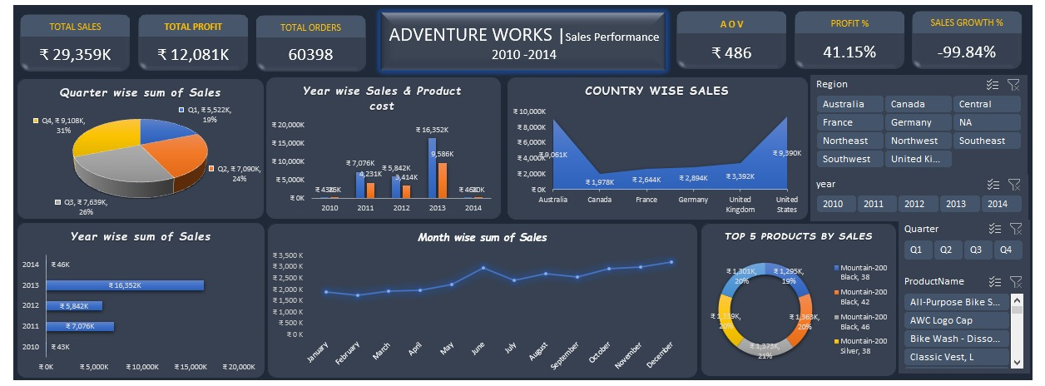
Excel Dashboard
Excel
Built using Power Query + Pivot Tables + Charts · Features: Yearwise & Monthwise analysis, Combo chart, Slicers by Year & Quarter

Slide 8
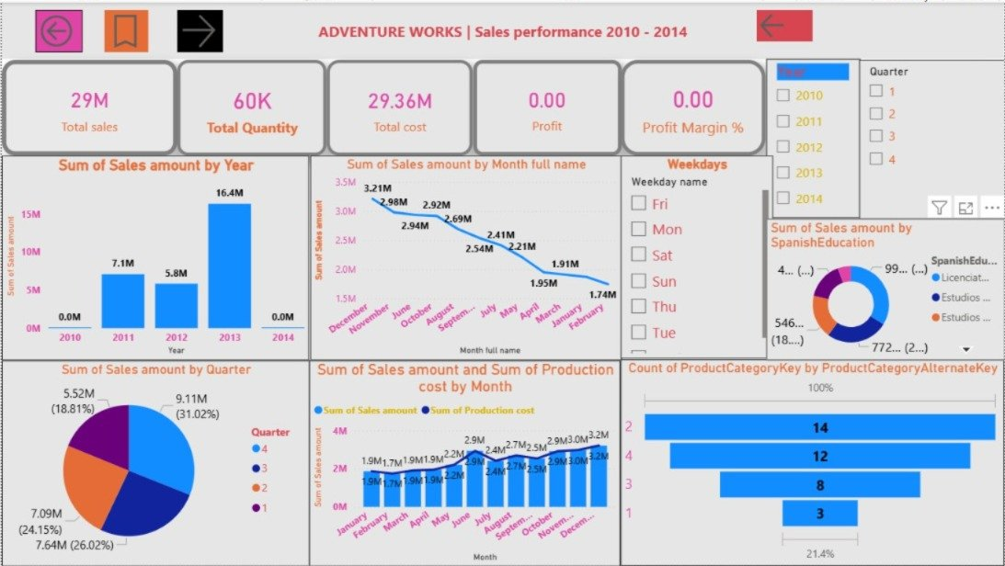
Power BI Dashboard
Power BI
Built using Power BI Desktop · Features: Interactive slicers (Region, Year, Quarter, Product), Map visual, KPI cards, Drill-through

Slide 9
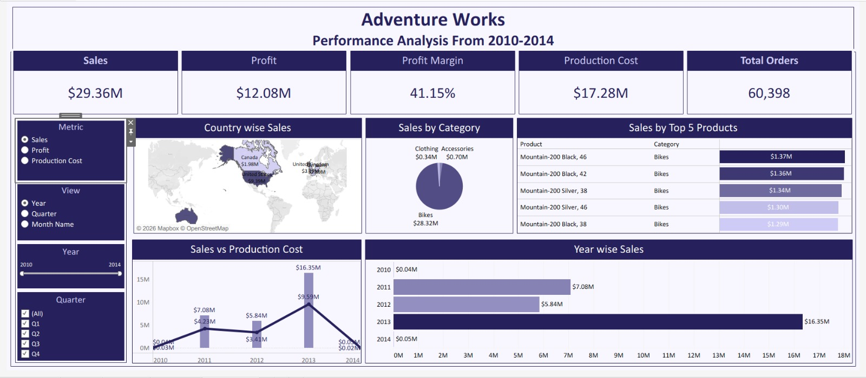
Tableau Dashboard
Tableau
Built using Tableau Desktop · Features: Year & Quarter filters, Countrywise map, Top 5 Products, Dynamic metric selector

Slide 10
Tool Comparison
Feature
Excel
Power BI
Tableau
Data Preparation
Power Query
Power Query
Data Source conn.
Relationships
Data Model
Power BI Model
Joins / Blending
Calculations
Excel Formulas
DAX Measures
Calculated Fields
Interactivity
Slicers / Filters
Report Filters
Filters / Actions
Visuals
Standard Charts
Rich visuals + AI
Advanced Charts
Sharing
Excel file
Power BI Service
Tableau Public/Server
Learning Curve
Low
Medium
Medium-High
Adventure Works | Sales Analysis 2010–2014

Slide 11
Key Insights & Findings
🏆 The Golden Year — 2013
🌍 Geographic Dominance
2013 was the peak performance year with $16.35M in sales, driven by strong product demand and geographic expansion.
United States led with ~$9.39M in sales, followed closely by Australia (~$9.06M). North America is the strongest region.
🚴 Bikes Drive Revenue
👥 Balanced Demographics
Bikes category accounts for $28.32M (96.5%) of total sales. Mountain-200 series are the top-5 best-selling products.
Sales split is almost equal: Male (50%) vs Female (49%), showing the brand has universal market appeal.
📅 Seasonal Patterns
💰 Healthy Profit Margin
Q4 is the strongest quarter (31% of sales). Sales dip in Q1 and recover steadily through the year.
41.15% profit margin maintained across the period, with $12.08M profit on $29.36M in total revenue.

Slide 12
Challenges Faced
01
Date Conversion
02
Data Merging
OrderDateKey was stored as an integer (e.g. 20130415). Converting it to a proper date field required custom formulas across all three tools.
Combining Fact tables and joining multiple Dimension tables required careful key mapping to avoid many-to-many relationship errors.
03
Financial Calendar
04
Dual Axis Formatting
Implementing a custom Financial Year (April = Month 1 through March = Month 12) required conditional logic in all tools.
Creating the combo chart (Sales + Production Cost) with a dual axis required specific chart formatting in each tool.
05
Performance at Scale
06
Cross-Tool Consistency
The merged dataset with 60K+ rows required query optimization in Power Query and Tableau to maintain dashboard responsiveness.
Ensuring the same KPI values appeared consistently across Excel, Power BI, and Tableau required careful formula alignment.
Adventure Works | Sales Analysis 2010–2014

Slide 13
Conclusion
Competitive Positioning
Insights reveal where Adventure Works outperforms competitors and where strategic improvement is needed, enabling stronger positioning in global markets.
Pricing Strategy
Profit margin analysis across products allows pricing adjustments to ensure sustainable profitability without impacting customer demand.
Resource Allocation
Regional and product performance visibility enables smarter allocation of marketing budgets, workforce, and production capacity.
Customer Retention
Identifying high-value customers enables targeted promotions and loyalty programs, improving retention and long-term revenue growth.
Adventure Works Cycles is now equipped to enhance profitability, optimize operations, and drive sustainable global growth through data-backed strategic decisions.

Slide 14
Thank You
Adventure Works Cycles | Sales Performance Analysis | 2010 – 2014
Excel
Power BI
Tableau
Group – 5 | Adabala Venkatesh Durga Sai | Prajakta Koli | Shraddha Muneshwar | Rohit Yadav | Dasari Venkatesh

